Slide 1
Psychoneuroimmunology and Immune-Related Disorders

Slide 2
Agenda
The Immune System
HIV and AIDS
Arthritis
Type 1 Diabetes

Slide 3
The Immune System
Psychoneuroimmunology – the study of how psychological factors (like mental health and behavior) and response-related systems of the body (particularly the nervous, endocrine, and immune systems) interconnect and impact health
The immune system is the surveillance system of the body
How do we see if the immune system is working?
See if immune cells (like lymphocytes) are active, proliferating, and transforming
Assess the production of antibodies in response to foreign material (like latent viruses)
Measure the level of immune system products (like cytokines)
Evaluate outcomes, such as wound healing speed

Slide 4
The Immune System & Stress
The immune system and stress have a complex relationship
Different kinds of stressors require different kinds of defenses
Ex: something short-term, like injury response vs. longer time-framed, like specific immunity development
Immune responses come at a cost, so efficiency requires that some immune aspects are suppressed
Stress impacts the sympathetic nervous system and the HPA axis, both of which influence immune functioning
Stress can impact other mental health aspects, such as negative affect, which also impacts health
Treating stress has led to better health outcomes in multiple studies

Slide 5
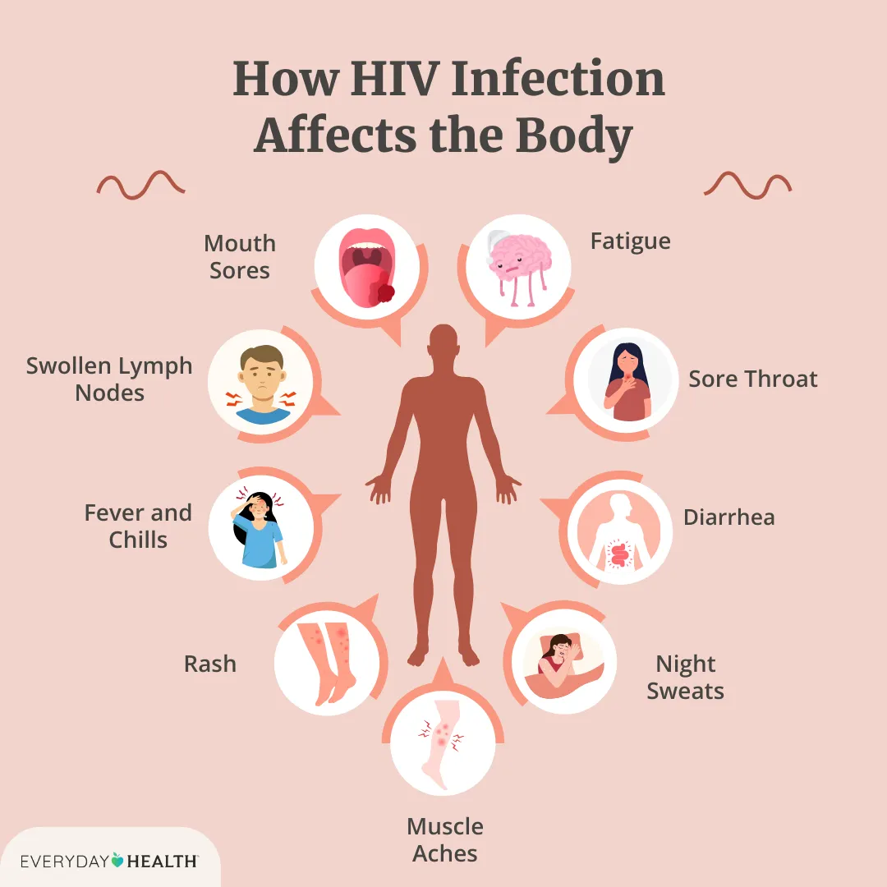
HIV and AIDS
Human immunodeficiency virus (HIV) – a retrovirus that attacks the helper T cells and macrophages of the immune system. HIV is (to our knowledge) only transferred through the exchange of cell-containing bodily fluids (ex: blood and semen).
HIV, if untreated, can progress to AIDS
Acquired immune deficiency syndrome (AIDS) – a chronic disease where the immune system is severely damaged

Slide 6
HIV and AIDS
Misconception: HIV can be spread through casual contact (hugging, kissing, etc.)
Fact: HIV can only be spread through cell-containing fluids (blood, semen [including pre-ejaculate], vaginal fluid, and breast milk)
Misconception: Gay men are responsible for the spread of HIV and AIDS
Fact: Worldwide, 70-75% of HIV cases pass between heterosexual contact
Misconception: Once you have HIV, you can never have sex again
Fact: HIV can be treated with a daily pill. After 1-6 months on the pill, HIV is undetectable in a patient
Undetectable = Untransmittable (U=U)

Slide 7

Living with HIV
https://www.youtube.com/watch?v=pjVI8iCoWoY

Slide 8
Arthritis
Arthritis – Greek for “joint inflammation;” a category of illnesses where the lining of joints become painful, stiff, and/ or swollen
Osteoarthritis – a form of arthritis caused by the articular cartilage around joints cracking and wearing away
Tends to affect weight-bearing joints, such as the hips, knees, and spine
Most patients are 50+ years old
Rheumatoid arthritis – an autoimmune disease where the immune system attacks the lining of the joints, causing pain, stiffness, and inflammation
This disease most often attacks people in the 40-60 age group, but can happen at any age
If unmanaged, the surrounding muscle and bone can be destroyed
Treatments for both forms of arthritis can include anti-inflammatory medication, weight control, exercise, and pain killers. Surgery may be involved in serious cases.

Slide 9
Type 1 Diabetes
Type 1 Diabetes – an autoimmune disorder where the immune system attacks the insulin-producing cells in the pancreas, leading to severe (and potentially deadly) insulin deficiency
Type 1 diabetes often develops early in life (typically between 4 and 7 years old, or 10 and 13 years old)
Early symptoms include: frequent urination, thirst, weight loss, fatigue, nausea, and good cravings
There is no cure, but can be managed with frequent monitoring and insulin injections (3-5 times per day)
Stress exacerbates type 1 diabetes

Slide 10
Type 1 Diabetes
Potential long-term complications: cardiovascular disease, neuropathy, kidney damage, eye damage, pregnancy complications, and skin conditions
Immediate risk: diabetic hypoglycemia – low blood sugar levels
Hypoglycemia warning signs: faded skin color, shaking, sweating, feel cold, irregular heartbeat, fatigue, difficulty concentrating
Call 911 if symptoms are severe
DON’T GIVE INSULIN – this will make their blood sugar drop more (insulin tells cells to absorb sugar from blood)
Instead, patients takes sugar pills or a glucagon shot/ nasal spray (a hormone that tells liver to release stored glucose)

Slide 11

Living with Type 1 Diabetes
https://www.youtube.com/watch?v=NJgh6lDV1UQ

Slide 12
Next Time on PSY 440…
Before Next Class:
Work on HIP
Complete today’s journal prompt
Due Friday at 11:59 pm
In Our Next Class:
Class Activity

